Slide 1
Bell Work:
Graph:
y = 4x – 5
Describe everything you know about this graph.

Slide 2
From Last Time
Pass Back Test

Slide 3
ALGEBRA 3
Day 33

Slide 4
4.1 – Quadratic Functions & Transformations 4.2 Standard Form of a Quadratic Function Objective: To graph (with and without a calculator) and identify the key points of a quadratic function. Vertex, Max or Min, Axis of Symmetry, Domain and Range, Transformations, Roots, Intercepts

Slide 5
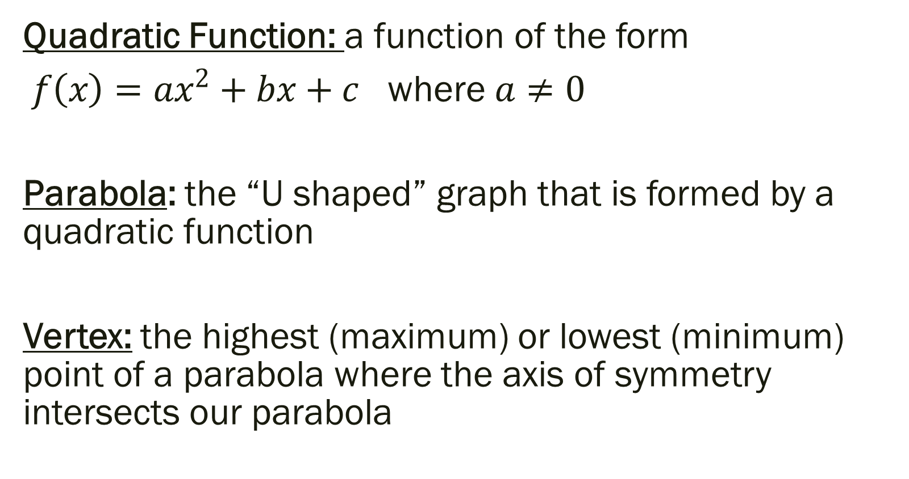
Vocabulary for the Unit
Quadratic Function: a function of the form
$f\left(x\right)=ax^{2}+bx+c$ where $a≠0$
Parabola: the “U shaped” graph that is formed by a quadratic function
Vertex: the highest (maximum) or lowest (minimum) point of a parabola where the axis of symmetry intersects our parabola

Slide 6
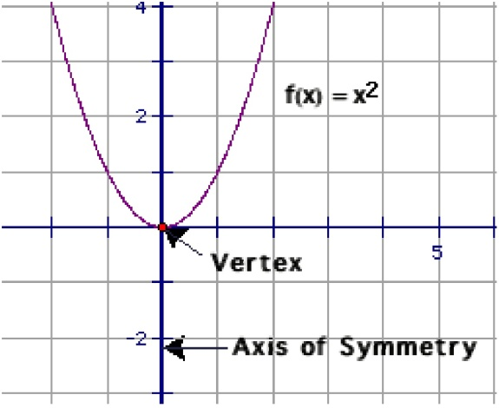
Vocabulary for the Unit
Axis of Symmetry: The vertical line that divides our parabola into two mirror images of each other by passing through the vertex.
Domain: all of the possible inputs
(x values)
Range: all of the possible outputs
(y values)

Slide 7
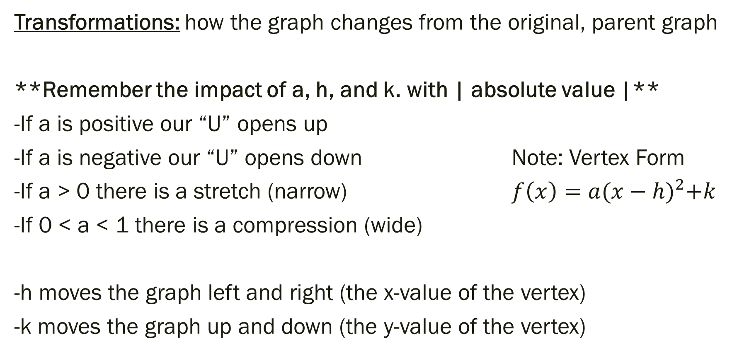
Vocabulary for the Unit
Transformations: how the graph changes from the original, parent graph
**Remember the impact of a, h, and k. with | absolute value |**
-If a is positive our “U” opens up
-If a is negative our “U” opens down Note: Vertex Form
-If a > 0 there is a stretch (narrow) $f\left(x\right)=a{(x−h)}^{2}+k$
-If 0 < a < 1 there is a compression (wide)
-h moves the graph left and right (the x-value of the vertex)
-k moves the graph up and down (the y-value of the vertex)

Slide 8
Vocabulary for the Unit
y-intercept: where the graph touches the y – axis
in other words, where x = 0
x-intercept: where the graph touches the x – axis
in other words, where y = 0
-- may reference as roots, zeros, solutions also

Slide 9
Steps to Graphing by Hand (won’t have to do this…)
Identify a, b and c.
1) Find and Plot Vertex
Substitute in x and solve for y
2) Draw Axis of Symmetry
Vertical line at
3) Find and Plot two points on one side of axis of symmetry
Choose x values and solve for y values
4) Use symmetry to plot symmetric points on opposite side of axis of symmetry
5) Draw a parabola through the plotted points

Slide 10
Graph the following and identify all the key terms.
Vertex,
Max or Min,
Axis of Symmetry,
Domain,
Range,
Transformations,
Roots,
y-intercepts

Slide 11

Examples:
${y=x}^{2}$ ${y=8x}^{2}$
$y={4x}^{2}+8x+9$ $y={0.2(x−3)}^{2}+1$
y = -2 (x + 4)(x – 3)

Slide 12
For Next Time
New Material:
Page 198 #4, 5, 15, 17
Page 206 #1-3, 9-11, 32, 38, 43
Mixed Review:
Page 208 # 57, 62, 63, 64

